Slide 1
Dr. Asmaa Sami Ibrahim Ph.D. Cytogenetic and Biology of fish
Cell Biology
Lecture 2
Second Level – First semester / 2020 – 2021

Slide 2
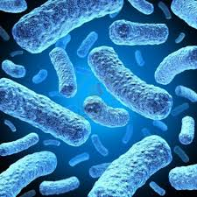
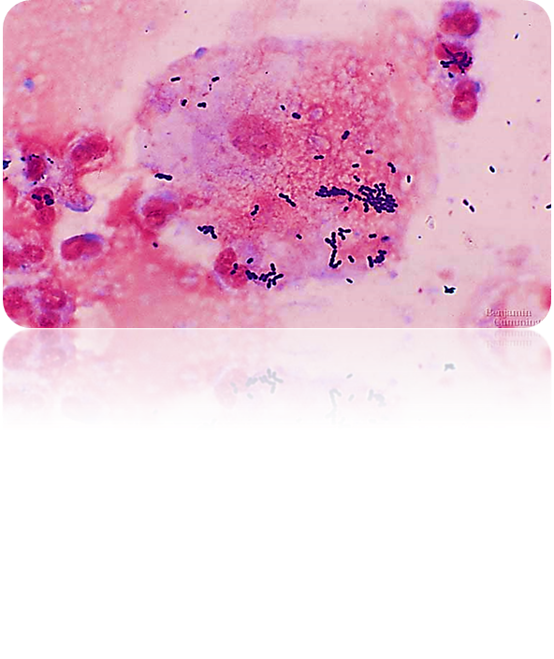
Cell biology Lec (2) Prokaryotes

Slide 3
Prokaryotes
1- They are everywhere, they exist almost everywhere, including places where eukaryotes cannot.
2- Prokaryotic cells are cells that do not have a true nucleus or most other cell organelles. Organisms that have prokaryotic cells are unicellular :
A. The nucleoid region in a prokaryotic cell consists of a concentrated mass of DNA.
B. A prokaryote may have a plasmid in addition to its major chromosome.

Slide 4
Prokaryotes
3. Bacteria and Cyanophytes are the two main branches of prokaryote.
4. Most bacteria have just one chromosome that is circular, which can range from about 160,000 base pairs (bp) to 12,200,000 bp. They also contain plasmids, which are small circular pieces of DNA that replicate independently of the chromosome.

Slide 5
Prokaryotes
5. Some bacteria can form endospores. These are tough, dormant structures that the bacteria can reduce themselves to under starvation conditions when not enough nutrients are available.
6. Most prokaryotes are useful; we could not live without them. For example, a large ration of the oxygen we breathe comes from prokaryotes in the ocean, using the CO₂ dissolved in the water, and making more "space" for CO₂ from the atmosphere to be absorbed by the ocean. In addition, they live in our gut.
7. Some cause diseases; ex. There are wide varieties of diseases caused by prokaryotes...for example bacterial meningitis, salmonella, diphtheria ….many others

Slide 6
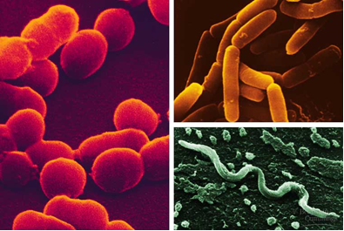
Prokaryotes
8. Prokaryotes are small 1-5 μm in size; but some can be seen by the naked eye, whereas Eukaryotic cells are typically 10-100 μm in diameter.
9.Three (3) common shapes: cocci (round); bacilli (rod); helical (spiral).

Slide 7
Prokaryotes
10. Almost prokaryotes have cell wall external to the plasma membrane.
11. The cell wall contains peptidoglycan, a polymer composed of linked carbohydrates and small proteins. The cell wall provides an extra layer of protection, helps the cell maintain its shape, and prevents dehydration.

Slide 8
Prokaryotes
12. Bacteria are grouped according to cell wall :
a. Gram-positive bacteria: have simple, thick cell walls. Their cell walls are composed of large amount of peptidoglycan.
b. Gram-negative bacteria: bacteria have less peptidoglycan and are more complex.
- Gram-negative bacteria are typically more resistant to host immune defenses and antibiotics.

Slide 9
Prokaryotes

Slide 10
Prokaryotes
13. Many bacteria also have an outermost layer of carbohydrates called the capsule. The capsule is sticky and helps the cell attach to surfaces in its environment.
14. Some bacteria also have specialized structures found on the cell surface, which may help them move, stick to surfaces, or even exchange genetic material with other bacteria. For instance, flagella are whip-like structures that act as rotary motors to help bacteria move.
15. Many prokaryotes move toward or away from a stimulus taxis. Chemotaxis is the movement toward or away from a chemical.

Slide 11
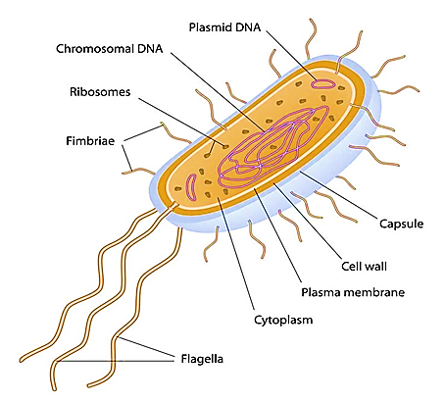
Bacteria VS Blue green algae

Slide 12
References:
Stephen R. B. , Jeremy S. H. , Elizabeth A. S. , Hugh A. W. & Claudia G. W. (2003).
CELL BIOLOGY (Second edition).
Harvey L. , Arnold B. , Paul M. , Chris A. K. , Monty K. , Matthew P. S. , Lawrence Z. & James D. ( 2003 ). Molecular Cell Biology (Fifth Edition ) .
Martin D., Stanley F., Eugene R., Karl-Heinz S. & Erko S. (2006). The Prokaryotes, A Handbook on the Biology of Bacteria , Third Edition, Springer Science+Business Media, Inc., 1003 p.
Regina B.(2019). What Are Prokaryotic Cells? Structure, Function, and Definition , Thought Co., 1 – 4 pp.
Sorin S. & Léo G. M. (2000). Prokaryotology , Presses de l’Université de Montréal , 108 pp.

